Slide 1
File I/O in C

Slide 2
Filing
So far, the operations using the C program are done on a prompt/terminal which is not stored anywhere.
The output is deleted when the program is closed.
We want to save information on some permanent storage media.

Slide 3
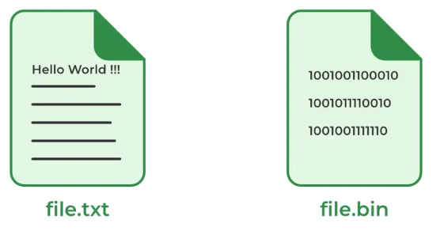
Types of Files in C
File
Text I/O
Binary I/O

Slide 4
Text Files
A text file contains data in the form of ASCII characters and is generally used to store a stream of characters.
Each line in a text file ends with a new line character (‘\n’).
It can be read or written by any text editor.
They are generally stored with .txt file extension.
Text files can also be used to store the source code/data.

Slide 5
Binary Files
A binary file contains data in binary form (i.e. 0’s and 1’s) instead of ASCII characters.
They contain data that is stored in a similar manner to how it is stored in the main memory.
The binary files can be created only from within a program and their contents can only be read by a program.
More secure as they are not easily readable.
They are generally stored with .bin/.dat/.log file extension.

Slide 6
C File Operations
create, open, read, write, and close
Creating a new file – fopen() with attributes as “a” or “a+” or “w” or “w+”
Opening an existing file – fopen()

Slide 7
C File Operations
Reading from file – fscanf() or fgets()
Writing to a file – fprintf() or fputs()
Closing a file – fclose()

Slide 8
File Pointer in C
FILE* pointer_name;

Slide 9
Open a File in C
FILE* = fopen(const char *file_name, const char *access_mode);
Parameters
file_name: name of the file when present in the same directory as the source file. Otherwise, full path.
access_mode: Specifies for what operation the file is being opened.
Return Value
If the file is opened successfully, returns a file pointer to it.
If the file is not opened, then returns NULL.

Slide 10
File opening modes in C
MODE for READ in TEXT | MODE for Write in TEXT | MODE for READ in BIN | MODE for Write in BIN
R (read) | w | rb | wb
A (append) |  | ab
r+ | wb | rb+
a+ |  | ab+

Slide 11
Open
int main()
{
FILE* fptr;
fptr = fopen(“filename.txt", "r");
if (fptr == NULL) {
printf("The file is not opened. The program will "
"now exit.");
exit(0);
}
return 0;
}

Slide 12
Create a File in C
FILE *fptr; fptr = fopen("filename.txt", "w");

Slide 13
Example
int main()
{
FILE* fptr;
fptr = fopen("file.txt", "w");
if (fptr == NULL) {
printf("The file is not opened. The program will "
"exit now");
exit(0);
}
else {
printf("The file is created Successfully.");
}
return 0;
}

Slide 14
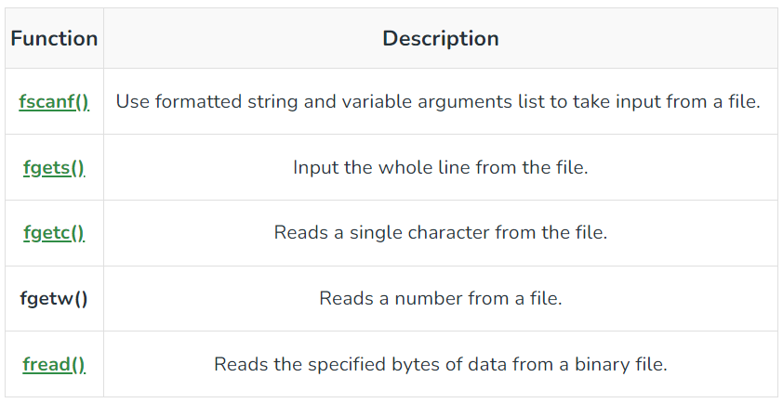
Reading From a File

Slide 15
FILE * fptr; fptr = fopen(“fileName.txt”, “r”); fscanf(fptr,"%s %s %s %d", &str1, &str2, &str3, &year); char c = fgetc(fptr);

Slide 16
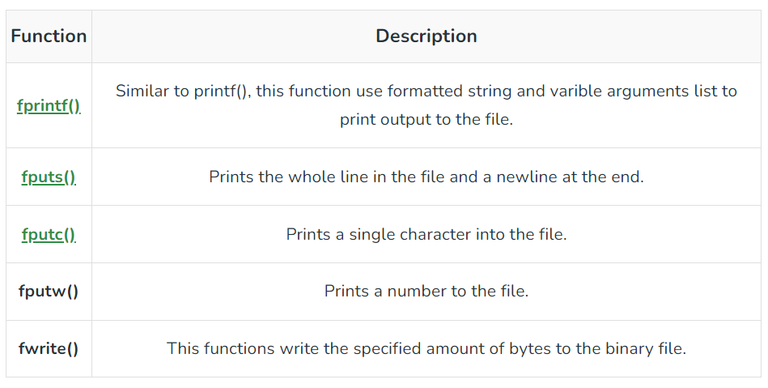
Write to a File

Slide 17
FILE *fptr ; fptr = fopen(“fileName.txt”, “w”); fprintf(fptr , "%s %s %s %d", "We", "are", "in", 2012); fputc("a", fptr);

Slide 18
Close File
fclose(file_pointer);

Slide 19
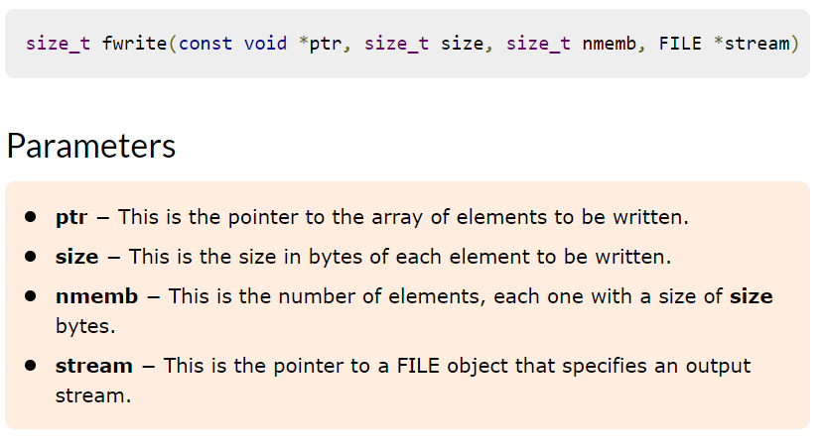
fwrite

Slide 20
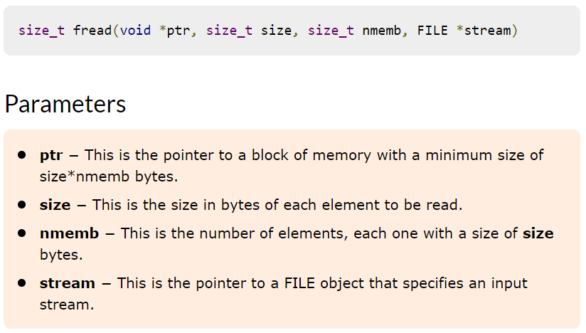
fread

